Slide 1
Spring Boot - Basics
Getting started with Spring Boot
Starter POMs, Auto-Configuration

Slide 2

Objectives
After completing this lesson, you should be able to:
  Explain what Spring Boot is and why it is Opinionated
  Describe how Spring Boot is driven by dependencies, properties and auto-configuration

Slide 3
Topics In This Session
What Is Spring Boot?
  Definition
  Example
Spring Boot Explained
  Dependency Management
  Auto Configuration
  Packaging
  Testing

Slide 4

Setting Up A Spring Application Can Be Tedious
Spring Applications typically require a lot of setup
  If working with JPA. You need:
    Datasource, TransactionManager, EntityManagerFactory ...
  If working with Spring MVC. You need
    WebApplicationInitializer, ContextLoaderListener, DispatcherServlet, ...
  An MVC app using JPA would need all of this
But much of this work is predictable, making it automatable
  Spring Boot can do most of this setup for you

Slide 5
What Is Spring Boot? (2 Of 2)
An opinionated runtime for Spring Projects
  Favors convention over configuration
  Uses sensible defaults, based on the contents of your classpath
    e.g. Sets up an EntityManagerFactory if an implementation is found on the classpath, and a project dependency requires this component
    e.g. Sets up a JdbcTemplate if an implementation is found on the classpath and a project dependency requires this component
Handles most low-level, predictable setup for you
  But can easily be overridden, if necessary
Supports a variety of standard application types
  Web, Batch, Integration
https://spring.io/projects/spring-boot
https://spring.io/guides/gs/spring-boot/
http://docs.spring.io/spring-boot/docs/current/reference/htmlsingle

Slide 6
Topics In This Session
What Is Spring Boot?
  Definition
  Example
Spring Boot Explained
  Dependency Management
  Auto Configuration
  Packaging
  Testing

Slide 7

Hello World Example
Just a few files are required to get a running desktop application
pom.xml
Setup Spring Boot dependencies
application.properties
Database setup
Application class
Application launcher
Maven is just one option. You can also use Gradle or Ant/Ivy.
Our slides will use Maven.

Slide 8
Hello World: Maven Descriptor (1 Of 2)
<parent>
<groupId>org.springframework.boot</groupId>
<artifactId>spring-boot-starter-parent</artifactId>
<version>2.0.0</version>
</parent>
<dependencies>
<dependency>
<groupId>org.springframework.boot</groupId>
<artifactId>spring-boot-starter-jdbc</artifactId>
</dependency>
<dependency>
<groupId>org.hsqldb</groupId>
<artifactId>hsqldb</artifactId>
</dependency>
</dependencies>
<!-- Continued on next slide. -->
Parent POM
Defines dependencies for:
Spring JDBC, JDBC Connection Pool, Spring Boot itself
Embedded SQL Database
pom.xml

Slide 9
Hello World: Maven Descriptor (2 Of 2)
We use a Spring Boot plugin to generate the application jar files
<!-- Continued from previous slide -->
<build>
<plugins>
<plugin>
<groupId>org.springframework.boot</groupId>
<artifactId>spring-boot-maven-plugin</artifactId>
</plugin>
</plugins>
</build>
pom.xml (continued)
Makes “fat” executable jars

Slide 10
Hello World: Application Properties
Spring Boot has many configuration properties
  We will see more throughout the course
  For now, configure the database
spring.datasource.schema=/testdb/schema.sql
spring.datasource.data=/testdb/data.sql
application.properties
Automatically configures HSQLDB as an embedded in-memory database – and populates by running specified scripts

Slide 11
Hello World: Application Class
@SpringBootApplication
public class Application {
public static final String QUERY = "SELECT count(*) FROM T_ACCOUNT";
public static void main(String [] args) {
ApplicationContext ctx = SpringApplication.run(Application.class, args);
JdbcTemplate jdbcTemplate = ctx.getBean(JdbcTemplate.class);
System.out.println("Hello, there are "
+ jdbcTemplate.queryForObject(QUERY, Long.class)
+ " accounts");
}
}
This annotation turns on Spring Boot behavior
@SpringBootApplication enables Spring Boot defaults
  e.g. Scanning classpath for dependencies expressed in pom.xml
  e.g. Processing application.properties
Demo: JdbcTemplate-I.zip
Created automatically by Spring Boot
Application.java
Main method will be used to run the packaged application from the
command line

Slide 12
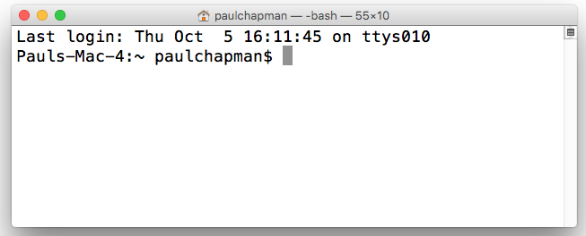
Putting It All Together
Maven command to generate an archive file
mvn package
helloApp-0.0.1-SNAPSHOT.jar
Generates “fat” executable jar
App started from command line
java -jar helloApp-0.0.1-SNAPSHOT.jar
$> java -jar helloApp-0.0.1-SNAPSHOT.jar
...
Hello, there are 24 accounts
...
$>
App runs and generates output

Slide 13
Topics In This Session
What Is Spring Boot?
  Definition
  Example
Spring Boot Explained
  Dependency Management
  Auto Configuration
  Packaging
  Testing

Slide 14




Spring Boot Needs Dependencies
Spring Boot works by analyzing the classpath in search of dependencies required to support your application
  If you forget a dependency, Spring Boot can't configure it
  A dependency management tool is recommended
    Because one of its responsibilities is to guarantee that the runtime classpath is configured properly
  Spring Boot parent and Spring starters make it much easier to capture these dependencies
Spring Boot works with Maven, Gradle, Ant/Ivy
  Our content here will show Maven

Slide 15
Spring Boot Parent POM
Parent POM
  Defines key versions of dependencies and Maven plugins
    Uses a dependencyManagement section internally
    You can override this section to customize the inherited dependencies
<parent>
<groupId>org.springframework.boot</groupId>
<artifactId>spring-boot-starter-parent</artifactId>
<version>2.0.0.RELEASE</version>
</parent>
Defines properties for dependencies, for example:
${spring.version} = 5.0.0.RELEASE

Slide 16
Spring Boot “Starter” Dependencies
Easy way to bring in multiple coordinated dependencies
  Including “Transitive” Dependencies
<dependencies>
<dependency>
<groupId>org.springframework.boot</groupId>
<artifactId>spring-boot-starter</artifactId>
</dependency>
</dependencies>
Resolves ~ 16 JARs!
spring-boot-*.jar spring-core-*.jar
spring-context-*.jar spring-aop-*.jar
spring-beans-*.jar aopalliance-*.jar
...
Version not needed!
Defined by parent.

Slide 17
Test “Starter” Dependencies
Common test libraries
<dependencies>
<dependency>
<groupId>org.springframework.boot</groupId>
<artifactId>spring-boot-starter-test</artifactId>
</dependency>
</dependencies>
Resolves
spring-test-*.jar
junit-*.jar
mockito-*.jar
…

Slide 18
Available Starter POMs
Not essential but strongly recommended
Coordinated dependencies for common Java enterprise frameworks
  Pick the starters you need in your project
To name a few:
  spring-boot-starter-jdbc
  spring-boot-starter-data-jpa
  spring-boot-starter-web
  spring-boot-starter-batch
See: Spring Boot Reference, Starter POMs
https://docs.spring.io/spring-boot/docs/current/reference/htmlsingle/#using-boot-starter

Slide 19
Benefits Of Using Starter POMs
Simplifies dependency management
  Particularly with regard to versioning
Eliminates problems associated with omitted dependencies

Slide 20
Creating a New Spring
Boot Project
SPRING INITIALIZR
Use Spring Initializr at https://start.spring.io
  Online Form: specify project meta-data, packaging, maven/gradle and your starters (dependencies)
  Create and download project zip
  Unzip and import into your IDE
STS: New Spring Starter Project Wizard
  Creates new project directly into STS
    Uses Spring Initializr to do so
No need to do this for the lab, but you will find it useful when starting your own applications. See appendix in lab-instructions.

Slide 21
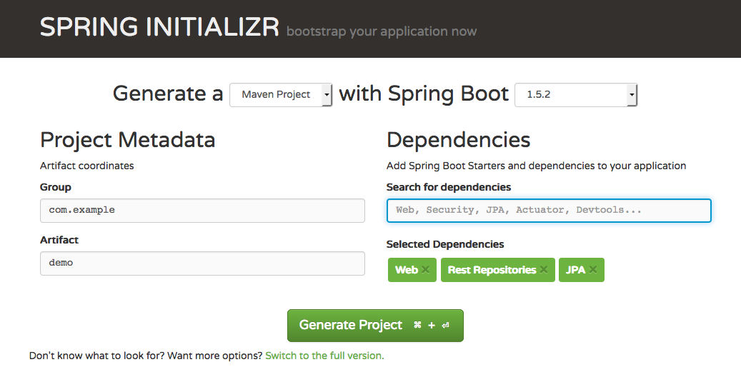
Spring Initializr Web Page
SPRING INITIALIZR
Specify dependencies
Switch to full version: more options, explicit check-list of dependencies

Slide 22
Topics In This Session
What Is Spring Boot?
  Definition
  Example
Spring Boot Explained
  Dependency Management
  Auto Configuration
  Packaging
  Testing

Slide 23
Spring Boot @EnableAutoConfiguration
When you attach the @EnableAutoConfiguration annotation to a Spring Java configuration class
  Spring Boot will automatically create the beans it thinks you need
  Usually based on classpath contents
  Without this (or an equivalent annotation) Spring Boot will not automatically create default Spring Beans found in the classpath
@Configuration
@ComponentScan
@EnableAutoConfiguration
public class Application {
public static void main(String[] args) {
SpringApplication.run(Application.class, args);
}
}
No packages specified = scan current package and all sub-packages
SpringApplication is actually a Spring Boot class

Slide 24
Shortcut: @SpringBootApplication
Very common to use @EnableAutoConfiguration, @Configuration (or its child @SpringBootConfiguration, which brings Spring Boot capabilities to Spring's testing framework), and @ComponentScan together
@Configuration
@ComponentScan
@EnableAutoConfiguration
public class Application {
...
}
@SpringBootApplication
public class Application {
...
}
@SpringBootConfiguration simply extends @Configuration – see @SpringBootTest for why.

Slide 25
Spring Boot Configuration Steps
Generally, Spring Boot configuration is the result of 3 steps
  You specify a dependency
  Spring Boot runs a pre-defined configuration that looks for that dependency
  The dependency is detected so some corresponding aspect of Spring is configured
    e.g. Wiring up a data source found in the classpath when you have included the jdbc starter in your POM file

Slide 26
Spring Boot Beneath The Hood
Beneath the hood, Spring Boot is nothing more than a large number of pre-written @Configuration files
Each one performs configuration conditionally (in the same way that @Profile allows Spring Beans to be created some times and not others)
  The conditional configuration in Spring Boot involves looking for certain classes on the classpath, based on the dependencies you specify in your application configuration files
https://dzone.com/articles/spring-boot-my-favorite

Slide 27
Auto-Configuration: Examples
At Runtime, Spring
Boot checks if
What Spring
Boot does
What you include
Embedded DB dependency
HSQLDB
(or H2 or Derby)
on classpath
Embedded DataSource registered
Starter JDBC
If DataSource registered
JdbcTemplate registered
If DataSource
not registered
Runtime Error: JDBC found with no datasource

Slide 28
Configuration Properties: application.properties
Developers commonly externalize properties to files
  Easily consumable via Spring Property-Source
  But developers name / locate their files different ways
Spring Boot looks for application.properties
  Many properties exist to control auto-configuration
  Can put any properties you need in here
    Boot will automatically find and load them
  Available to Environment and @Value in usual way
Yes, this does violate the principle of “Separation of concerns”
See Appendix A of Spring Boot documentation:
http://docs.spring.io/spring-boot/docs/current/reference/html/common-application-properties.html

Slide 29
Example: External Database
Configuring an external database
  Such as MySQL
  Make sure project defines JDBC driver dependency
spring.datasource.url=jdbc:mysql://localhost/test
spring.datasource.username=dbuser
spring.datasource.password=dbpass
spring.datasource.driver-class-name=com.mysql.jdbc.Driver
spring.datasource.schema=/testdb/schema.sql
spring.datasource.data=/testdb/data.sql

Slide 30
Example: Controlling Logging Level
Boot can control the logging level
  Just set it in application.properties
Works with most logging frameworks
  Java Util Logging, Logback, Log4J, Log4J2
logging.level.org.springframework=DEBUG
logging.level.com.acme.your.code=INFO
application.properties
Try to stick to SLF4J in the application.
The advanced section covers how to change the logging framework

Slide 31
Topics In This Session
What Is Spring Boot?
  Definition
  Example
Spring Boot Explained
  Dependency Management
  Auto Configuration
  Packaging
  Testing

Slide 32

Packaging
Spring Boot creates your archive
  JAR (or WAR)
Gradle and Maven plugins are available
  These plugins generates an executable JAR for your application
  java -jar yourapp.jar

Slide 33
Maven Packaging
Recall: Spring Boot Maven plugin in pom.xml
<build>
<plugins>
<plugin>
<groupId>org.springframework.boot</groupId>
<artifactId>spring-boot-maven-plugin</artifactId>
</plugin>
</plugins>
</build>

Slide 34
Packaging Result
Running the mvn package command produces the following jar files (in the maven target directory)
  .jar.original contains only your code (a traditional JAR file)
    Use when deploying to a “properly configured” environment
  .jar contains your code and all libs – executable
    Notice that it is much bigger
    Use when deploying to an unknown environment
    Everything required to support the application is contained in the jar file itself
22M yourapp-0.0.1-SNAPSHOT.jar
5K yourapp-0.0.1-SNAPSHOT.jar.original

Slide 35
Topics In This Session
What Is Spring Boot?
  Definition
  Example
Spring Boot Explained
  Dependency Management
  Auto Configuration
  Packaging
  Testing

Slide 36
Testing: @SpringBootTest (1 Of 2)
@ExtendWith(SpringExtension.class)
@SpringBootTest(classes=Application.class)
public class TransferServiceTests {
@Autowired
private TransferService transferService;
@Test
public void successfulTransfer() {
TransferConfirmation conf = transferService. transfer(...);
...
}
}
Loads the specified configuration applying same Spring Boot defaults
@Configuration
@EnableAutoConfiguration
@ComponentScan(“transfers”)
public class Application {
// Bean methods
}

Slide 37
Testing: @SpringBootTest (2 Of 2)
@SpringBootTest causes Spring Boot to use same configuration for the test as Spring Boot uses for the class being tested
  So if Application defines a Spring Boot application, with a public static main() method invoking SpringApplication.run(Application.class, args), then the test will use the same Spring Boot setup the Application uses when run as an application
  e.g. If Application uses JPA and JPA is on the classpath, then Spring Boot will setup a TransactionManager, EntityManagerFactoryBean and, given the right properties or dependencies, a DataSource for the resulting test

Slide 38
Testing: @SpringBootConfiguration
Spring Boot can find the configuration class for itself
  Provided it is in a package above the test
  Only one @SpringBootConfiguration class is allowed in the application hierarchy
@ExtendWith(SpringExtension.class)
@SpringBootTest // classes not needed
public class TransferServiceTests {
// Same tests as previous slide
}
@SpringBootConfiguration
@EnableAutoConfiguration
@ComponentScan("transfers")
public class Application {
// Bean methods
}
≡ @SpringBootApplication(scanBasePackages="transfers")

Slide 39
Summary
Spring Boot significantly simplifies Spring setup
  Will setup much of your application for you
  Uses in-built defaults (opinions) to do the obvious setup
  Many properties available to customize what it does
  Use @SpringBootTest to enable Spring Boot in tests
See optional Advanced Spring Boot section in Student Handout PDF for more on Spring Boot configuration and usage.

